Slide 1


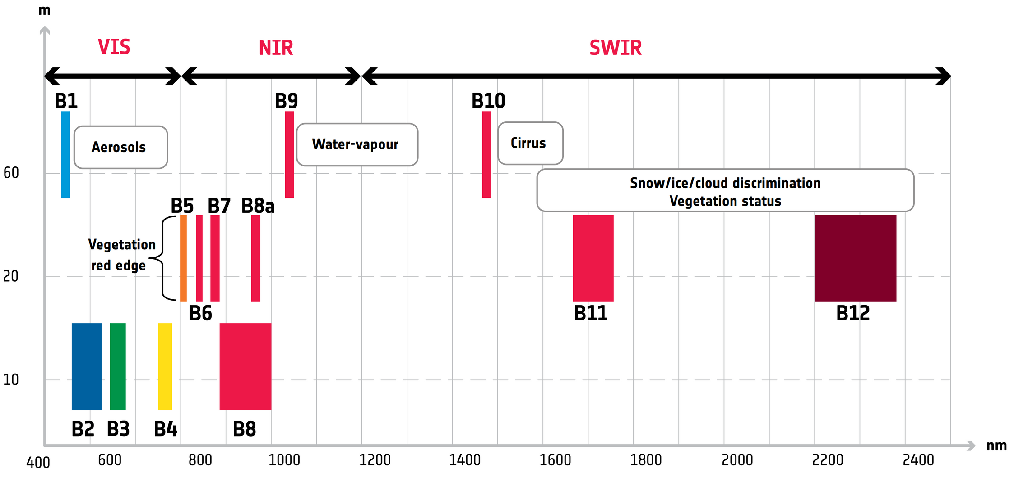
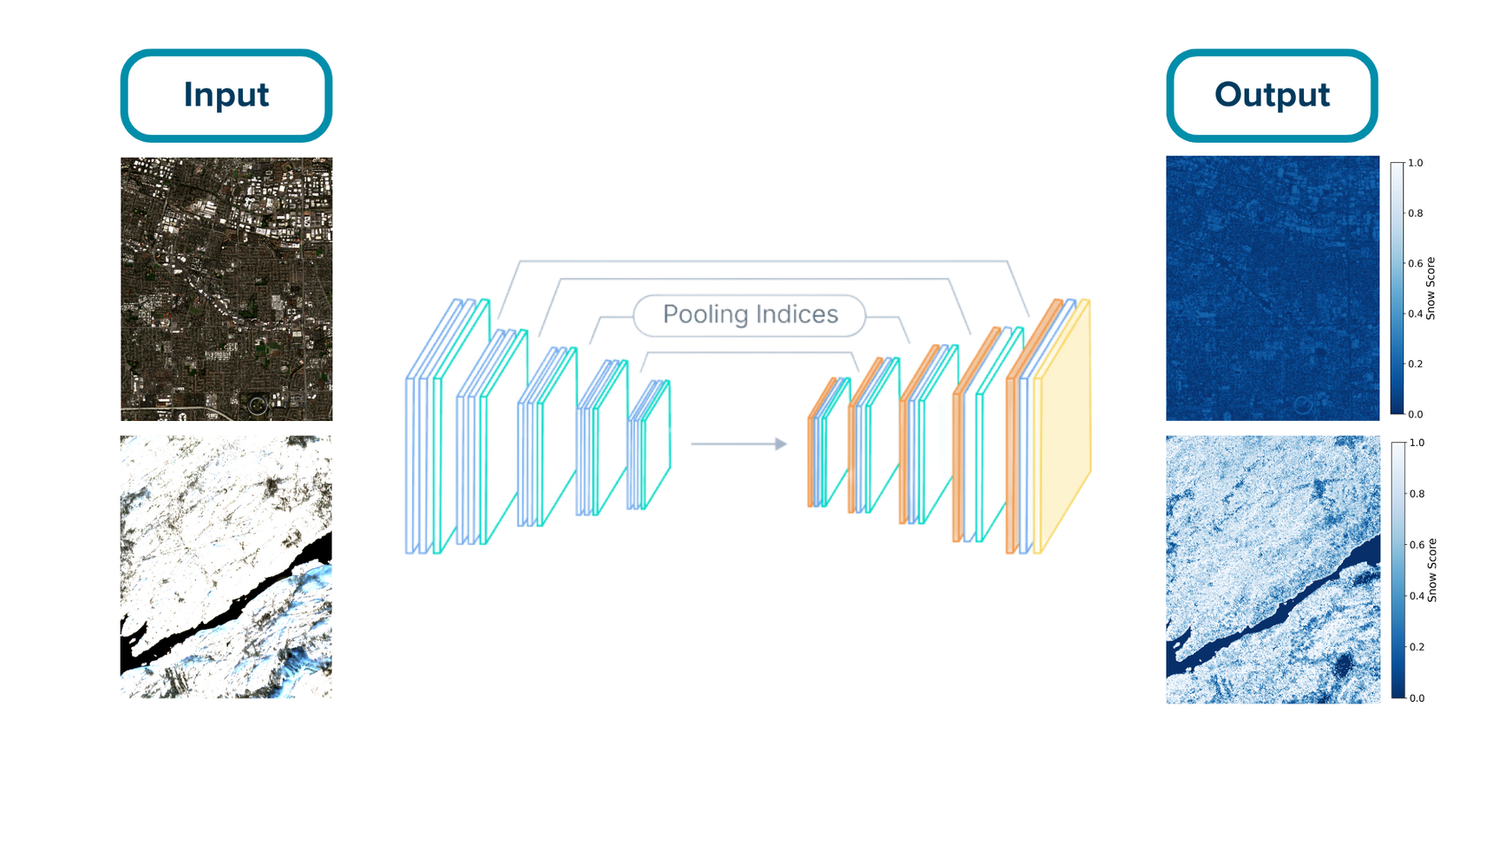
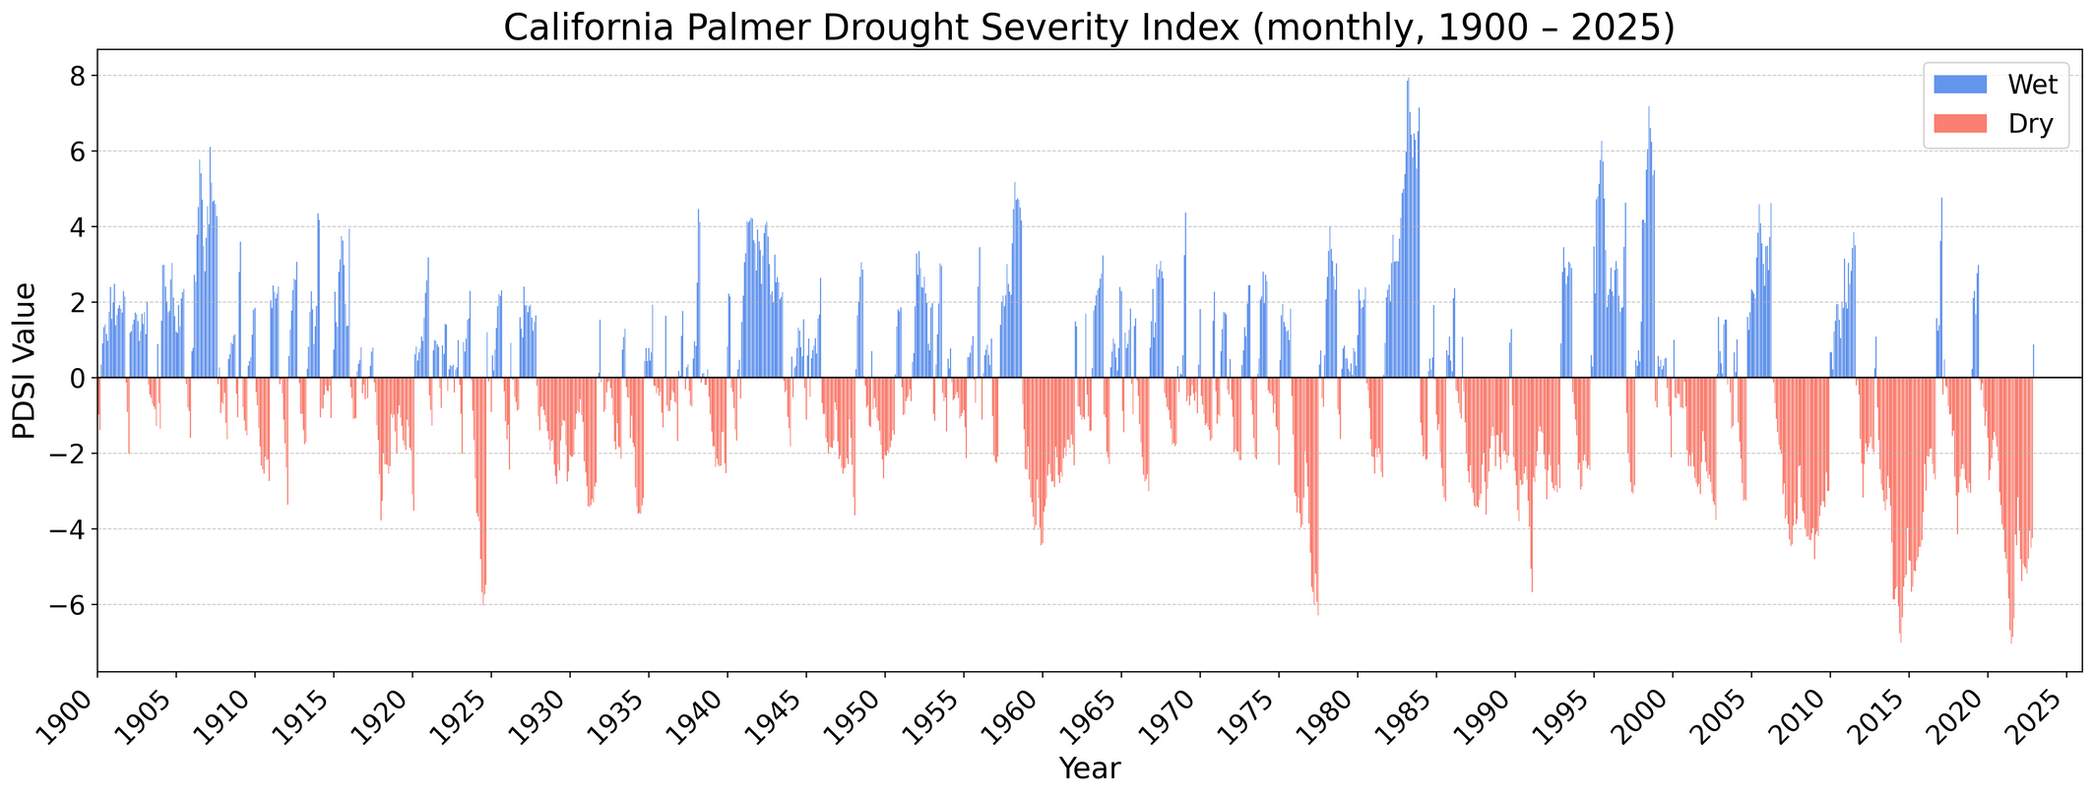
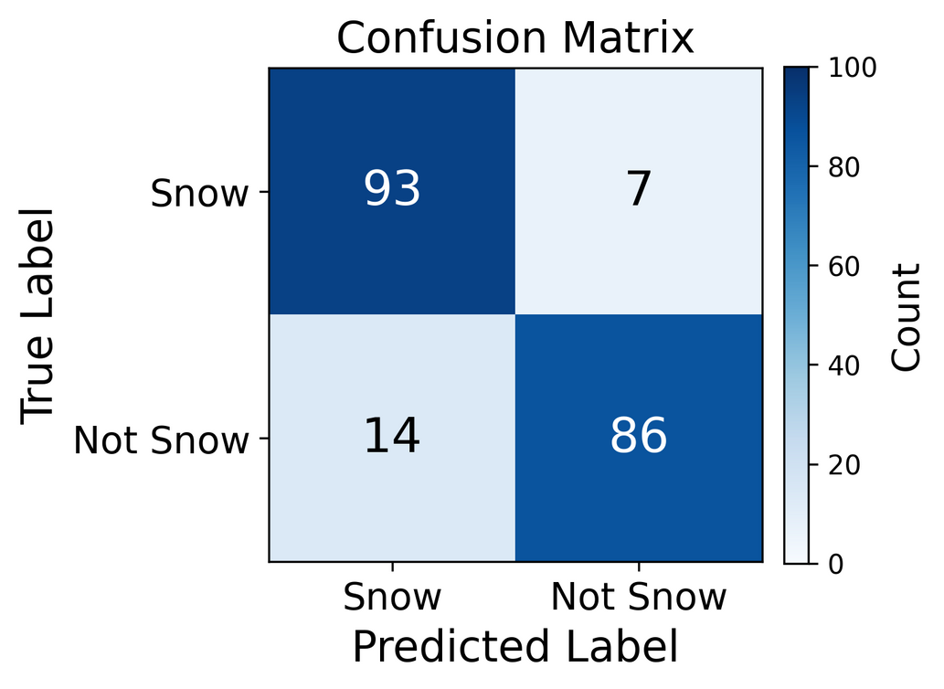
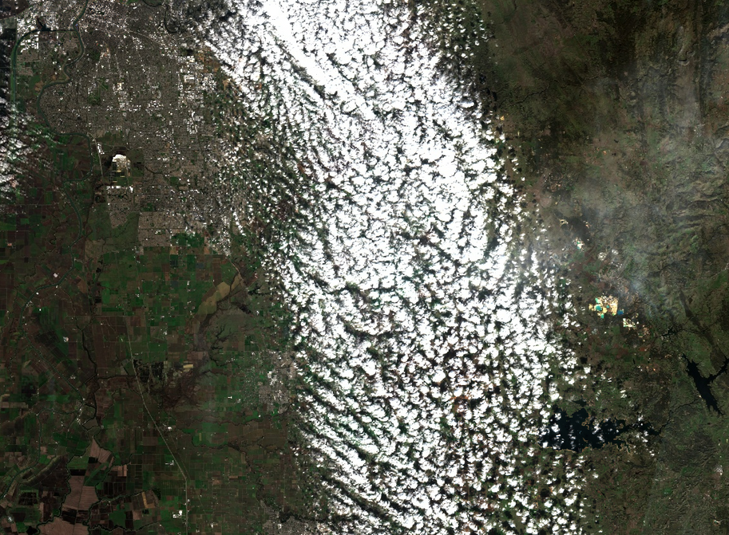
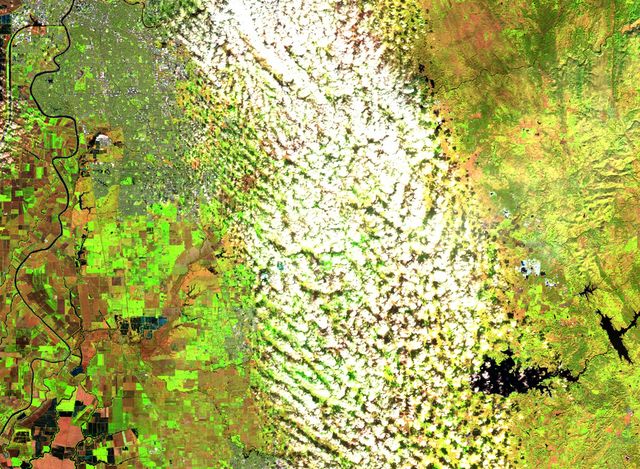
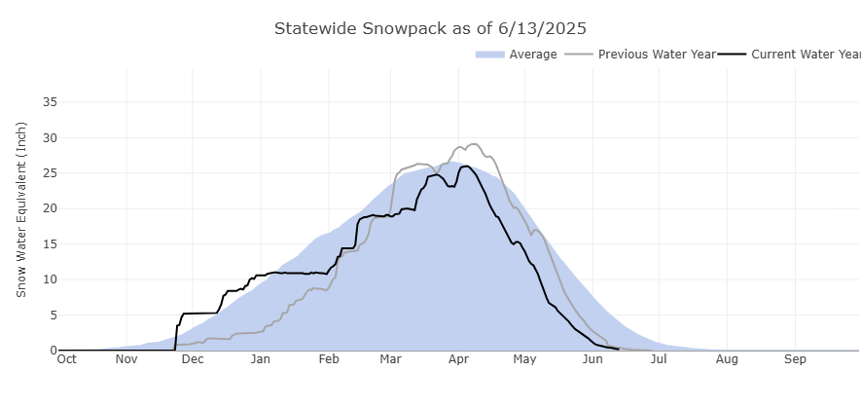
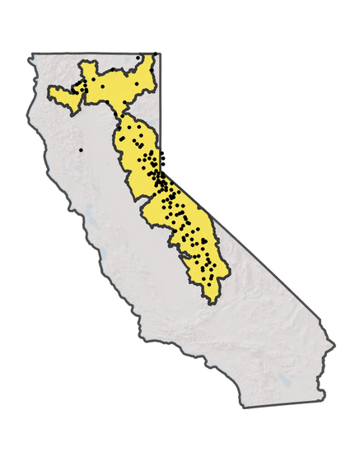
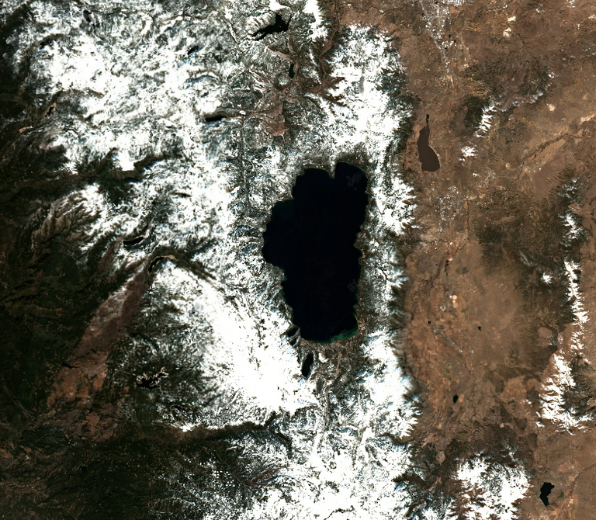
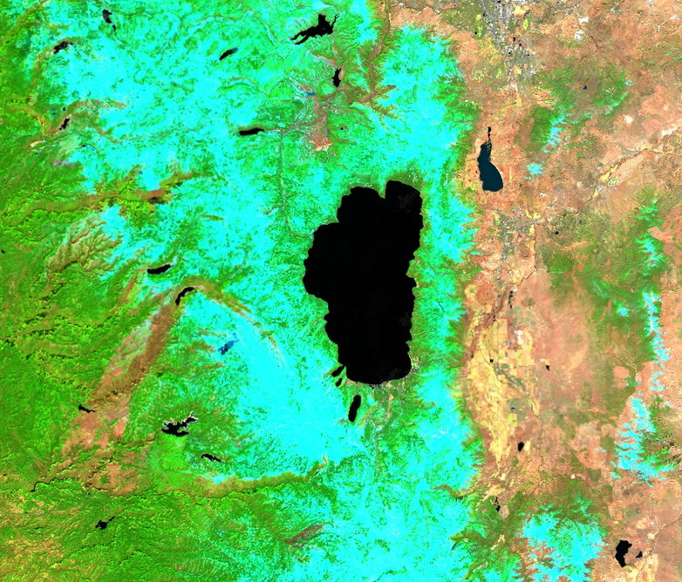
Deep Learning-Based Snow Monitoring in California Using Sentinel-2 Satellite Data for Management of Snowpack Resources
Vivian Jiaheng Sun, Mohammadreza Narimani
1. Computer Science Department, University of California, Davis
2. Biological and Agricultural Engineering Department, University of California, Davis
1
2
ABSTRACT
Sentinel-2 satellites capture data across 13 spectral bands ranging from visible (VIS) to shortwave infrared (SWIR) wavelengths. These bands enable detailed observation of Earth’s surface, including vegetation health, water content, cloud properties, and snow/ice discrimination. For snow monitoring, specific bands in the SWIR region (B11 and B12) are particularly valuable for separating snow from clouds and other bright surfaces.
A dataset of 100 snow-covered images and 100 non-snow images (including agricultural land, desert, urban areas, and ocean) was used to train a convolutional encoder-decoder network. Data was split into 60% for training, 15% for validation, and 25% for testing. The model outputs a pixel-wise probability map, indicating the likelihood of snow presence for each pixel.
Accurate snow monitoring is essential for managing California’s water resources, where snowpack serves as a vital seasonal reservoir. Declining snowpack and increasing drought frequency highlight the need for reliable, automated monitoring systems. This study uses Sentinel-2 multispectral imagery to distinguish snow from clouds, urban areas, farmland, and other bright surfaces. Spectral analysis identified shortwave infrared bands (B11 and B12) as especially effective for snow detection. A convolutional encoder-decoder deep learning model was trained on 100 snow and 100 non-snow images, achieving an accuracy of 89.5%, precision of 86.9%, and recall of 93.0%. The model generates pixel-wise snow probability maps, enabling large-scale and repeatable monitoring. The results demonstrate the potential of combining remote sensing and deep learning to provide timely, high-quality data for water resource planning. This approach offers a robust and scalable tool to support drought resilience and sustainable water management in California.
INTRODUCTION
California’s climate history reveals a clear trend toward increasing drought frequency and severity. The Palmer Drought Severity Index (PDSI) shows prolonged dry periods, with particularly severe droughts in recent decades. These conditions highlight the urgent need for accurate and timely snowpack monitoring to support sustainable water resource management.
Figure 3. Sentinel-2 spectral bands (VIS, NIR, and SWIR) with key applications, including snow and cloud discrimination in SWIR bands [3].
Figure 5. Deep Learning framework for snow detection. Input: Sentinel-2 imagery. Output: Pixel-level snow probability map.
METHODOLOGY
RESULTS
Using standard RGB composites from Sentinel-2 imagery can make snow detection challenging, as snow, clouds, and bright urban surfaces all appear white. By creating a false color composite using Bands 11 (SWIR), 8 (NIR), and 4 (Red), snow becomes spectrally distinct from clouds and other bright features, enabling more accurate identification.
The deep learning model demonstrated strong performance in snow classification, achieving high accuracy and recall. The confusion matrix shows effective separation of snow and non-snow classes, while the evaluation metrics confirm balanced precision and recall, indicating reliable detection capabilities.
RGB
B11, B8, B4
Metric | Value
Accuracy | 0.89
Precision | 0.86
Recall | 0.93
F1-Score | 0.89
IoU | 0.81
Figure 1. California PDSI (1900–2025), with blue indicating wet periods and red indicating drought [1].
Snowpack in California’s Sierra Nevada serves as a vital seasonal water source, gradually releasing meltwater to support rivers, reservoirs, and agriculture during dry months. Year-to-year fluctuations strongly influence water availability, making continuous monitoring essential for drought management and sustainable water allocation.
Figure 6. Left: Confusion matrix for snow classification. Right: Performance metrics including accuracy (0.895), precision (0.869), recall (0.930), F1-score (0.899), and IoU (0.816).
REFERENCES
[1] National Centers for Environmental Information (NCEI), National Oceanic and Atmospheric Administration (NOAA). (n.d.). Climate at a Glance: Statewide Time Series – California Palmer Drought Severity Index (PDSI), January 1895–December 2022. Retrieved August 13, 2025, from NOAA NCEI Climate at a Glance website.
[2] California Department of Water Resources. (2025). California Water Watch: Snowpack as of August 12, 2025. Retrieved August 13, 2025, from https://cww.water.ca.gov/
[3] European Space Agency (ESA). (2015). Sentinel-2: ESA Bulletin 161 (pp. 8–9). Retrieved August 13, 2025
[4] V7 Labs. (n.d.). Autoencoders: Guide to convolutional encoder–decoder networks. Retrieved August 13, 2025, from https://www.v7labs.com/blog/autoencoders-guide
Figure 2. Left: Statewide snowpack trends vs. historical average. Right: Snow monitoring stations in the Sierra Nevada [2].
Figure 4. Comparison of RGB and false color (B11, B8, B4) composites from Sentinel-2. The false color imagery clearly distinguishes snow from clouds and other bright surfaces.
Notes:
1

